Slide 1


cloud.iO Introduction & Thesis presentation
Michael Clausen & Lucas Bonvin

Slide 2
Why cloud.iO?

Slide 3
Motivation for cloud.iO
Realtime Monitoring
Our problems:
Each time a new solution for similar problems is developed.
There is not that much budget to create a stable/flexible solution.
Data analyst has to work each time with different systems.
Data of different projects are not simple to compare and may have to be converted first.
Scientists can not easily share their data with others.
Control often is not possible, as the data passes by a database.
Monitoring is mostly very inefficient (Database Polling for example)
Data Analysis
My Solution
Data Analysis
Colleague A Solution
Realtime Monitoring
Data Analysis
Colleague B Solution

Slide 4
SCADA
Automation
Health
Supervision
Internet
of
Things
Social
Data
Exploration
Scientific
Data Acquisition
Data
Analysis
Building
Control

Slide 5
cloud.iO Concepts

Slide 6
Actors
Endpoint
Publishes it’s complete data model.
Sends messages when some data of the model changes.
Some data can be modified from the outside (control, parameters).
User/Application
Has access right on one or more „Endpoints“.
Can give access to Endpoint to other users/applications.
Has access to a subset of all „Endpoints“ data models.
Can search for actual data using schemes (interfaces, data-classes).
Can get actual and historical data for „Endpoints“.
Can control set points and parameters of „Endpoints“.
Endpoint
Application
User

Slide 7
cloud.iO Architecture

Slide 8


Overview
RabbitMQ
MQTT publish/subscribe
AMQP
Message broker
Microservices
AMQP RPC
Backends
REST Proxy
HTML &
REST API
MQTT
subscribe
Endpoints
Monitoring
User

Slide 9
Backends
Authentication / Permission
Endpoint Repository
Logs Repository
History Repository
MongoDB
Backend
InfluxDB
Backend

Slide 10
Endpoint structure
MQTT
Endpoint
D640cdd70-1bdb-11e4-8c21-0800200c9a66
*
Node
D640cdd70-1bdb-11e4-8c21-0800200c9a66/Heat-Pump
*
Object
*
D640cdd70-1bdb-11e4-8c21-0800200c9a66/Heat-Pump/Status
*
Attribute
…1e4-8c21-0800200c9a66/Heat-Pump/Status/Active

Slide 11
Topic / Json Object model
Endpoint: D640cdd70-1bdb-11e4-8c21-0800200c9a
{
„uuid“: „640cdd70-1bdb-11e4-8c21-0800200c9a66“, „nodes“: {
„Meteo“: {
„implements“: [„MeteoStation“],
„objects“: {
„temperatures“: {
„conforms“: null,
„objects“: {
„inside“: {
„conforms“: „TemperatureMeasure“,
„attributes“: {
„unit“: {
„constraint“: „Static“,
„timestamp“: null,
„value“: „K“
},
„temperature“: {
„type“: „Number“,
„constraint“: „Measure“,
„timestamp“: 45878945.457,
„value“: 19.2
}
}
}
}
}
}
}
}
}
Topic: @UPDATE/D640cdd70-1bdb-11e4-8c21-0800200c9a/Meteo/temperatures/inside/temperature
{
„TYPE“: „Number“,
„constraint“: „Measure“,
„timestamp“: 45878945.457,
„value“: 19.2
}

Slide 12
Master thesis: enhance cloud.iO

Slide 13
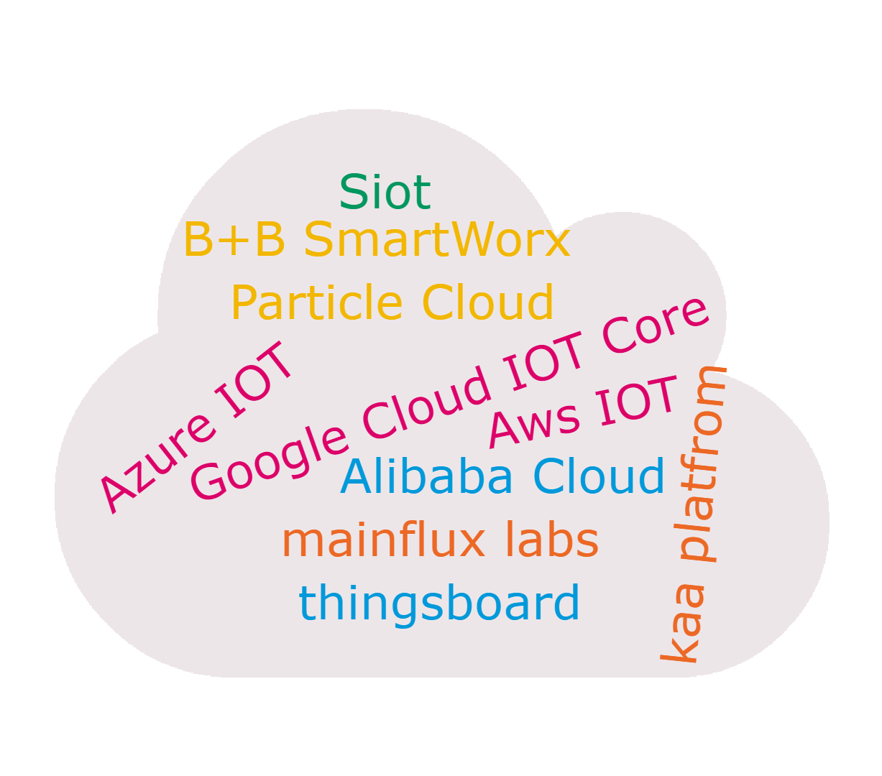
Clouds analysis
What is missing in cloud.iO
A complete REST API
Remote execution of jobs on Endpoint
What is missing in IoT Clouds
Standardization
What are cloud.iO plus
Unique access control architecture
Standardization
Open Source

Slide 14
Normalization with W3C WoT
cloud.iO Version of Node
WoT (reduced) Version of Node
{
"demoNode": {
"implements": [],
"objects": {
"demoObject": {
"objects": {
},
"attributes": {
"demoMeasure": {
"constraint": "Measure",
"type": "Number",
"timestamp": 1569488908.013,
"value": -0.850433133901474
},
"demoSetpoint": {
"constraint": "SetPoint",
"type": "String",
"timestamp": -1.0
}
}
}
}
}
}
{
"properties": {
"demoSetpoint": {
"type": "Integer",
"forms": [{
"href": "https://localhost:8081/api/v1/getAttribute",
"op": "readproperty"
},
{
"href": "mqtts://localhost:8883/@set/bc0f1bf8-bdae-11e9-9cb5-2a2ae2dbcce4/demoObject/demoSetpoint",
"op": "writeproperty"
},
{
"href": "https://localhost:8081/api/v1/setAttribute",
"op": "writeproperty"
}]
}
},
"events": {"updateDemoObjectDemoSetpoint": {
"data": {
"type": "Integer"
},
"forms": [{
"href": "https://localhost:8081/api/v1/notifyAttributeChange",
"op": "longpoll",
"subprotocol": "observeProperty"
},
{
"href": "mqtts://localhost:8883/@set/bc0f1bf8-bdae-11e9-9cb5-2a2ae2dbcce4/demoObjectdemoSetpoint",
"op": "subscribeEvent"
}]
}
}

Slide 15
Open source
http://cloudio.hevs.ch
https://github.com/cloudio-project
cloudio-rabbitmq-docker
cloudio-services
cloudio-documents
cloudio-documentation
cloudio-endpoint-java
cloudio-endpoint-python
cloudio-grafana-plugin
cloudio-project.github.io

